Slide 1
SCRUM Overview
IT Academy Experts’ group
January, 2011
Approved by Ivan Hitskaylo
07.2014

Slide 2

Scrum Agenda
SCRUM intro
Scrum Release Cycle
Diagram of Flow
Scrum framework
Roles
Time boxes
Artifacts
Summary

Slide 3
SCRUM Intro
Scrum is the framework which consists of a set of Scrum Teams and their associated roles; Time-Boxes, Artifacts, and Rules.
Scrum Teams:
Self-organizing and cross-functional;
work in iterations.
Consists of the following three roles:
Scrum Master, who is responsible for ensuring the process is understood and followed;
Product Owner, who is responsible for creation and managing requirements;
Team, which does the work.

Slide 4
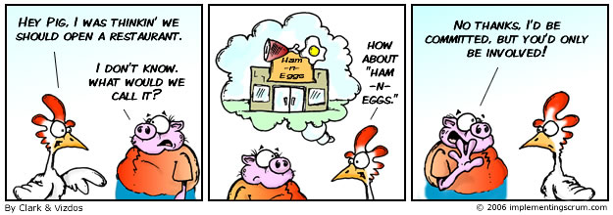
SCRUM Intro

Slide 5
Analysis
Design
Development
Testing
Sprint 1
Sprint 2
Sprint 3
Sprint 4
Sprint 5
Sprint …
Release Cycle

Slide 6
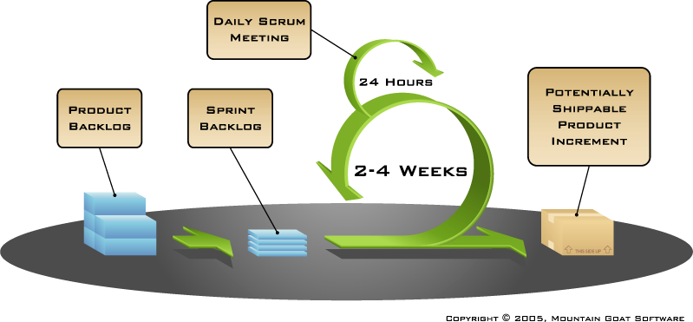
Diagram of Flow

Slide 7
Diagram of Flow
Scrum projects make progress in a series of “sprints”
Analogous to Extreme Programming iterations
Typical duration is 2–4 weeks or a calendar month at most
A constant duration leads to a better rhythm
Product is designed, coded, tested and documented during the sprint

Slide 8
Diagram of Flow
Requirements
Design
Code
Test
Rather than doing all of one thing at a time…
...Scrum teams do a little of everything all the time

Slide 9
Scrum Framework
Roles
Product Owner
Scrum Master
Team
Time boxes
Sprint
Sprint planning
Daily Scrum
Sprint Review
Sprint Retrospective
Artifacts
Product Backlog
Sprint Backlog
Burndown Charts

Slide 10
Scrum Framework
Roles
Product Owner
Scrum Master
Team
Time boxes
Sprint
Sprint Planning
Daily Scrum
Sprint Review
Sprint Retrospective
Artifacts
Product Backlog
Sprint Backlog
Burndown Charts

Slide 11
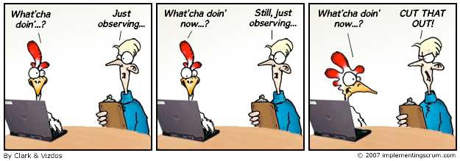
Scrum Master Role

Slide 12
Scrum Master
Responsibilities:
Responsible for enacting Scrum values and practices
Removes the barriers between the team and the customer
Ensures that the team is fully functional and productive
Enables close cooperation across all roles and functions
Shields the team from external interferences

Slide 13
Scrum Master
Responsibilities:
Scrum Master is responsible for the Scrum process
Teaching the organization how to use Scrum
Teaching Product Owner and Team how to fulfill their roles within Scrum process
Facilitating the creativity inside the team
Improving tools and practices used
No authority

Slide 14
Scrum Master
Who is Scrum Master
“Leader of the band”
“Conductor of the orchestra”
“Sheep dog”

Slide 15
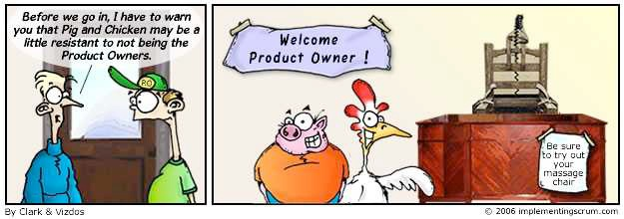
Product Owner

Slide 16
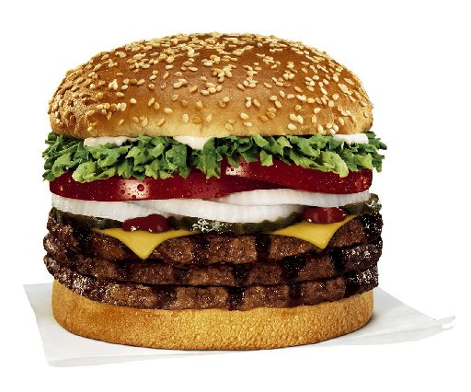
Product Owner
Exercise:
You are working at “Fat Burger” and are the only person on duty
A customer approaches and orders a “Double Fat Burger Deluxe” with onions, cheese and bacon with fries and a coke
You ring up the order. The price is $5.65.
The customer informs you that he only has $1.20
What do you do and what do you tell the customer?

Slide 17
Product Owner
Responsibilities:
Defines the features of the product
Decides on release date and content
Responsible for the profitability of the product (ROI)
Prioritizes features according to market value
Adjusts features and priority every iteration, as needed
Accepts or reject work results

Slide 18
Prioritization

Slide 19
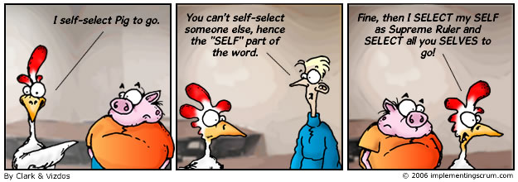
Team

Slide 20
Team
Typically 7+/-2 people
Cross-functional
Programmers, testers, user experience designers, etc.
Members should be full-time
May be exceptions (e.g., database administrator)
Teams are self-organizing
Ideally, no titles but rarely a possibility
Membership should change only between sprints

Slide 21
Team
Everyone necessary to go from product backlog to potentially shippable product increment, including:
Programmers
Testers
Analysts
DBAs
Tech Writers
UI Designers
Etc

Slide 22

Exercise
You are the Scrum Master and …
The analyst on the project wants to work one sprint ahead so that the analysis is ready when the programmers need it
The tech writers want to work one sprint behind so that they are “more efficient.”
What do you do?

Slide 23
Scrum framework
Roles
Product Owner
Scrum Master
Team
Time boxes
Sprint
Sprint Planning
Daily Scrum
Sprint Review
Sprint Retrospective
Artifacts
Product Backlog
Sprint Backlog
Burndown Charts

Slide 24
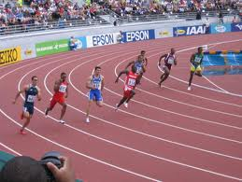
Sprint

Slide 25
Sprint
Sprint planning
4/4 hrs
Sprint Review and Retrospectives
4/4 hrs
Development Work
2-4 weeks sprint

Slide 26
Sprint
2-4 weeks iteration
Team does work from product backlog
Team commits to achieve the sprint goal
Team plans work for sprint on a Sprint Planning meeting
Team demos work completed on a Sprint Review Meeting
Every day team highlights progress on a Daily Scrum meeting
Sprint Burndown chart is used to visualize team progress

Slide 27
Sprint
Abnormal Termination
Sprint can be cancelled if Team cannot meet Sprint goals
Management can cancel Sprint if external circumstances breaks Sprint goal
If Sprint is terminated, next step is to have next Sprint Planning meeting, review the reason of termination and start another Sprint

Slide 28

Sprint Planning

Slide 29
Sprint Planning
Sprint Planning Meeting
Sprint Prioritization
Analyze and evaluate Product Backlog
Select sprint goal
Team
Capacity
Sprint
Goal
Product
Backlog
Sprint Prioritization
Decide how to achieve sprint goal (design)
Create sprint backlog (tasks) from product backlog items (user stories / features)
Estimate sprint backlog in hours
Sprint
Backlog
Technology

Slide 30
Sprint Planning
Team selects items from the product backlog they can commit to completing
Sprint backlog is created
Tasks are identified and each is estimated (1-16 hours)
Collaboratively, not done alone by the Scrum Master
High-level design is considered

Slide 31

Sprint Planning
As a vacation planner, I want to see photos of the hotels.
Code the middle tier (8 hours)
Code the user interface (4 hours)
Write test fixtures (4 hours)
Code the foo class (6 hours)
Update performance tests (4 hours)

Slide 32
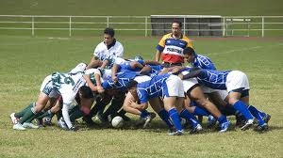
Daily Scrum

Slide 33
Daily Scrum
Parameters
Daily
15-minutes
Stand-up
Not for problem solving
Whole world is invited
Only team members, Scrum Master, Product Owner can talk
Helps avoid other unnecessary meetings

Slide 34
Daily Scrum
Progress Documents
Sprint Tracker/Sprint Backlog
Sprint Burndown Chart
Whiteboard
Scrum Tools
Excel
Version One
Rally
Etc.

Slide 35
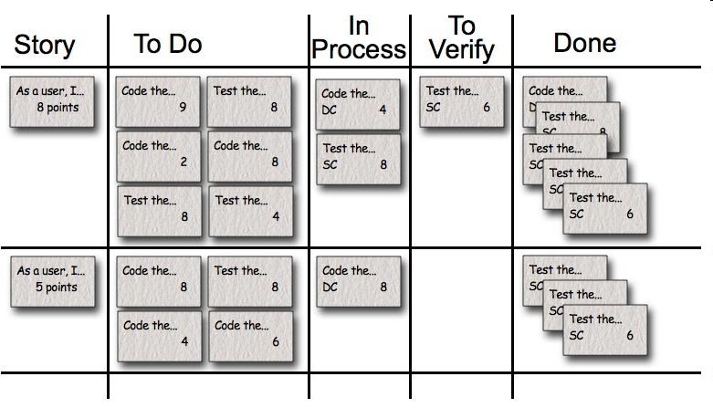
Daily Scrum

Slide 36
Daily Scrum
Everyone answers 3 questions, which aren’t not status for the Scrum Master, but they are commitments in front of peers
1
What did you do yesterday?
2
What will you do today?
3
Is anything on your way?

Slide 37

Sprint Review

Slide 38
Sprint Review
Team presents what it accomplished during the sprint
Typically takes the form of a demo of new features or underlying architecture
Informal
2-hour prep time rule
No slides
Whole team participates
Invite the world

Slide 39
Sprint Review
Unfinished work goes to the Product Backlog.
Update the Product Backlog based on work completed by the team – expected and unexpected.
Reformulate the team – do we have the “right” team members for the next sprint.
Reprioritizing the Product Backlog to take advantage of opportunities that the completed work presents.
Requesting that the project progress be sped up by authorizing additional teams to work on the Product Backlog.

Slide 40
Sprint Retrospective
Periodically take a look at what is and is not working
Typically 15–30 minutes
Done after every sprint
Whole team participates
Scrum Master
Product owner
Team
Possibly customers and others

Slide 41
Sprint Retrospective
Whole team gathers and discusses what they’d like to:
Start doing
Continue doing
Stop doing

Slide 42
Sprint Retrospective
Team selects 3-5 most important items to address
At the beginning of each retrospective meeting team reviews items that were selected previous time

Slide 43
Scrum Framework
Roles
Product Owner
Scrum Master
Team
Time boxes
Sprint
Sprint Planning
Daily Scrum
Sprint Review
Sprint Retrospective
Artifacts
Product Backlog
Sprint Backlog
Burndown Charts

Slide 44

Product Backlog

Slide 45
Product Backlog
Where IT Meets The Business
IT
Business

Slide 46

Product Backlog
The requirements
A list of all desired work on the project
Ideally expressed such that each item has value to the users or customers of the product
Prioritized by the product owner
Reprioritized at the start of each sprint
This is the product backlog

Slide 47
Product Backlog
Requirement | Priority
Set up Christmas Tree in living room | 10
Decorate windows in New Year style | 20
Organize sitting place | 30
Organize listening the music | 40
Cook different dishes to the holiday table | 50
... | 60

Slide 48
User Story
User stories are short, clear description of the functionality that will be valuable for the customer or user of the product
Benefits of User Stories:
Stories shift focus from writing to talking
Stories are understandable by users and developers
Stories support iterative development
Stories are the right size for planning

Slide 49
User Story
User Story Template
As a <type of user>, I can <goal> so that <reason>

Slide 50
User Story
As a guest, I want to have sitting place
As a house owner, I want to see Christmas Tree in living room
As a guest, I want to have ability to listen the music

Slide 51
User Story
Product Backlog with User Stories
Backlog item | Estimate (story points)
As a house owner, I want to see Christmas Tree in living room | 8
As a house owner, I want to have New Year decorated windows | 5
As a guest, I want to have sitting place | 1
As a guest, I want to have ability to listen the music | 3
As a guest, I want to have different dishes on the holiday table | 21
... | 30

Slide 52
User Stories Characteristics
Independent
Negotiable
Valuable
Estimatable
Small
Testable

Slide 53
User Stories
[Olha] I propose to delete this example at all
Exercise:
Write the following user stories
System should work on Windows XP
Rewrite SQL select statement to decrease time of its execution
Build system should build the sources and run unit tests every night

Slide 54
User Stories
What is DONE?
When is user story done for:
Programmer
Tester
User Experience Designer
DB Architect
?
When is user story done for customer?

Slide 55
User Story
A story is complete (DONE) when:
Coded/implemented
Peer reviewed (pair programming counts as peer review)
Code is run against current version in source control
Code is commented in source control and checked in
Acceptance test suites are updated and executed with no failures
All critical and blocker bugs found in acceptance test are resolved and verified
Unit Tests written and passing (0 failing in your build components)

Slide 56
User Story
Performance Unit Tests written and passing and no regression on existing Performance Unit Tests
Code coverage of unit tests must not regress
Test Strategies are updated and reviewed by the team
All development-based doc items (including Java Docs) are completed
Performance Review by performance architect* (*for items requiring review)
UI Reviewed with UE representative on team* (*for UI-oriented items)

Slide 57
Estimation and Planning
Exercise:
What is the distance to:
Kyiv
London
Tokyo
How long it will take to travel to these cities?
Which one is the longest/shortest distance?

Slide 58
Estimation and Planning
The “bigness” of task
Unit-less values
Relative values
Typically Fibonacci numbers are used except 2:
1, 3, 5, 8, 13
Other options
T-Shirt sizes: XS, S, M, L, XL, …

Slide 59
Estimation and Planning
Dogs
Bulldog (бульдог)
Pekingese (пекінес)
Doberman (доберман)
Poodle (пудель)
Dog (дог)
Evaluated size
M
XS
L
S
XL

Slide 60
Estimation and Planning
Story Points Advantages
Drive cross-functional behavior
Allows apple to apple comparison
Pure measure of size
Estimation is fast
Estimating the size not the duration
Duration is determined empirically by seeing how much is complete per sprint
Units can be added together
Time estimates are not additive

Slide 61
Planning Poker
An iterative approach to estimating
Steps
Each estimator is given a deck of cards, each card has a valid estimate written on it
Product owner reads a story and it’s discussed briefly
Each estimator selects a card that’s his or her estimate
Cards are turned over so all can see them
Discuss differences (especially outliers)
Re-estimate until estimates converge

Slide 62
Planning Poker
Estimate these
Product backlog item | Estimate
Read a high-level, 10 page overview of agile software development in magazine
Write the product backlog for your friend who owns the clock store and now wants an ecommerce site
Recruit, interview and hire new member to your team
Read a 150-page of art book
Wash your boss’ car

Slide 63
Sprint Backlog
The sprint goal is a short statement of what the work will be focused on during the sprint
Examples of goals:
Make the application run on SQL Server in addition to Oracle.
Support more technical indicators than company ABC with real-time, streaming data.
Support features necessary for population genetics studies.

Slide 64
Sprint Backlog
Managing Sprint Backlog
Individuals sign up for work of their own choosing (Work is never assigned)
Estimated work remaining is updated daily
Any team member can add, delete or change the sprint backlog
Work for the sprint emerges
If work is unclear, define a sprint backlog item with a larger amount of time and break it down later
Update work remaining as more becomes known

Slide 65
Product Backlog
Backlog item | Estimate (story points)
As a house owner, I want to see Christmas Tree in living room | 8
As a house owner, I want to have New Year decorated windows | 5
As a guest, I want to have sitting place | 1
As a guest, I want to have ability to listen the music | 3
As a guest, I want to have different dishes on the holiday table | 21
... | 30

Slide 66
Sprint Backlog
Tasks | Mon | Tue | Wed | Thur | Fri
As a mother, I want to see Christmas tree in living room
Select and measure a place for the Christmas Tree | 1 | 0 | 0 | 0 | 0
Select color, size and style for Christmas decorations (toys, Christmas tree ornaments etc) | 3 | 0 | 0 | 0 | 0
Buy Christmas Tree | 4 | 0 | 0 | 0 | 0
Buy Christmas decorations | 8 | 8 | 6 | 7 | 0
Install Christmas Tree | 0.5 | 0.5 | 0.5 | 0 | 0
Decorate the Christmas Tree | 3 | 3 | 3 | 3 | 3
As mother to take a look if this is what she expected | 0.5 | 0.5 | 0.5 | 0.5 | 0.5

Slide 67
Sprint Burn Down Chart

Slide 68
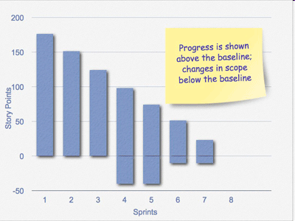

Slide 69

Questions
Thank You!
Copyright © 2010 SoftServe, Inc.

